Slide 1
Software Defect Prediction via Convolutional Neural Network
汇报：高鼎力 高文新

Slide 2
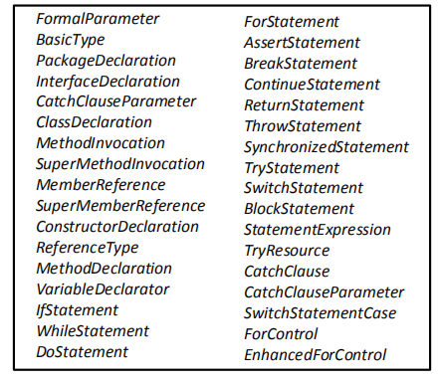
Nodes select
Only select three types of nodes on ASTs as tokens
nodes of method invocations and class instance creations.
declaration nodes
control-flow nodes
Convert each source file into a token vector

Slide 3
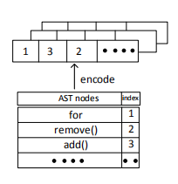
Encodeing Tokens and Handling Imbalance
1. Encoding Tokens:
Build a mapping between integers and tokens.
Convert token vectors into integer vectors.(range 1 to total number of token types)
Put 0 to eatch interger vectors makeing their lengths consistent.

Slide 4
Encodeing Tokens and Handling Imbalance
What is imbalance？
Software defect data set are often imbalanced, in which the number of buggy instances is much less than the number of clean instances.

Slide 5
Example:
Our training examples:
- 990 clean examples
- 10 buggy examples
If we use this kind of data set, our network will more likely to make a prediction : clean.
Because it can get a high accuracy.

Slide 6
Solution:
If reduce the clean files, will lose some information.
So to solve this problem, duplicate training intances from the minority class(buggy files)

Slide 7

What we have now?
Vectors with the same length.

Slide 8
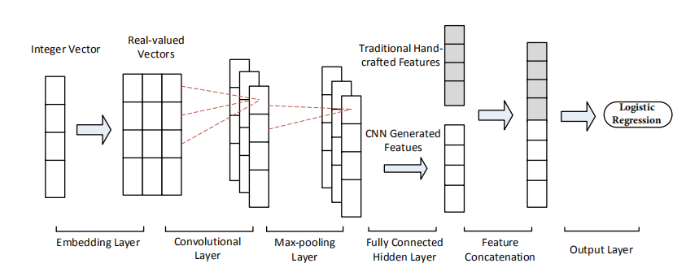
CNN Architecture

Slide 9
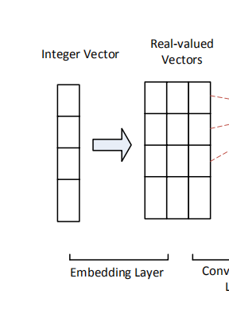
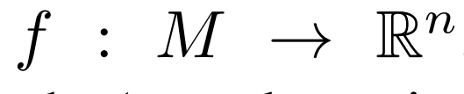
Word embedding
defined as
M represents tokens in this work
f is a parameterized function mapping words to n-dimensional vectors

Slide 10
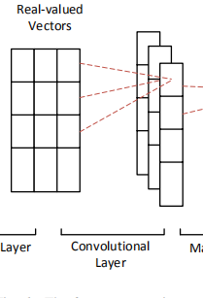
Con. layer

Slide 11
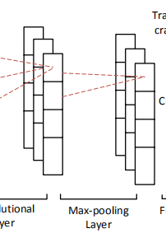
Max-pooling layer

Slide 12
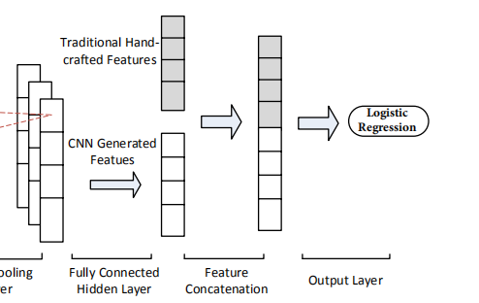
Neurl network Layer

Slide 13
Logistic Regression
sigmoid activation

